Slide 1

Anti-bullying app
Aryaman Mishra,hashwanth s.,Akhil raman,harshanth p.

Slide 2
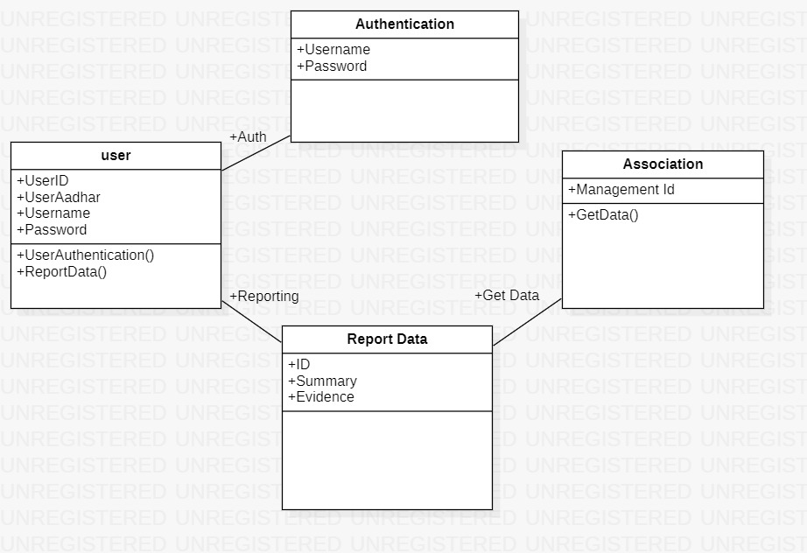
CLASS DIAGRAM

Slide 3
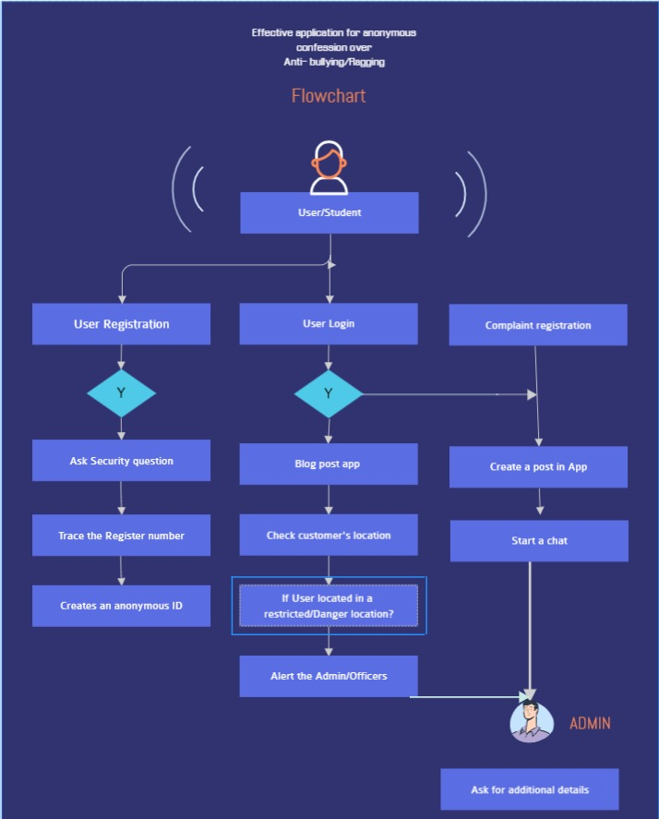
Flow chart

Slide 4
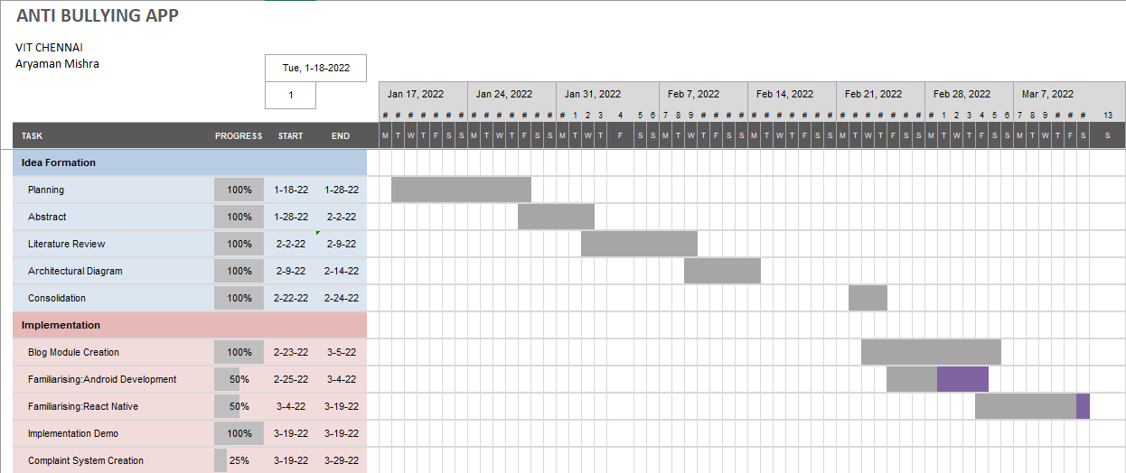
GANTT CHART

Slide 5
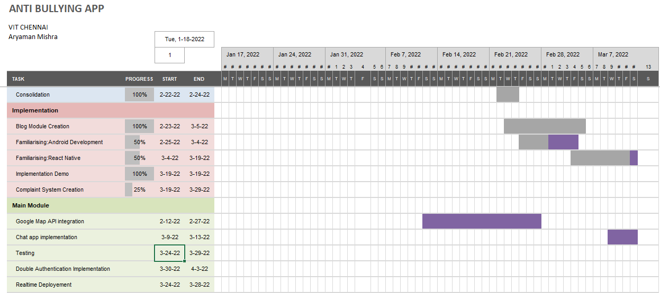
Contd.

Slide 6
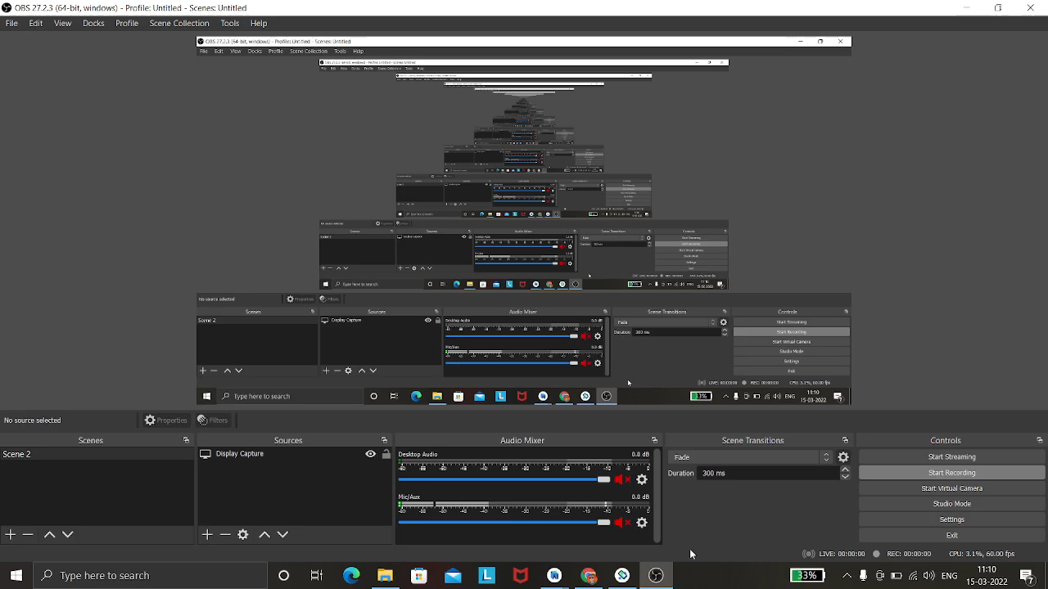
Demo video(incase live demo faulters)

